Slide 1
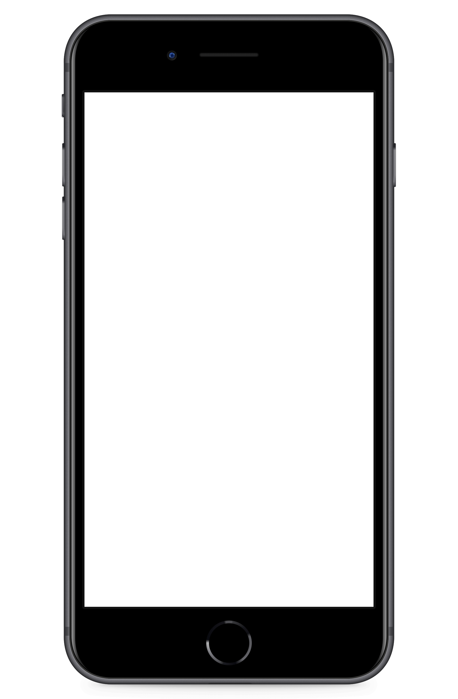
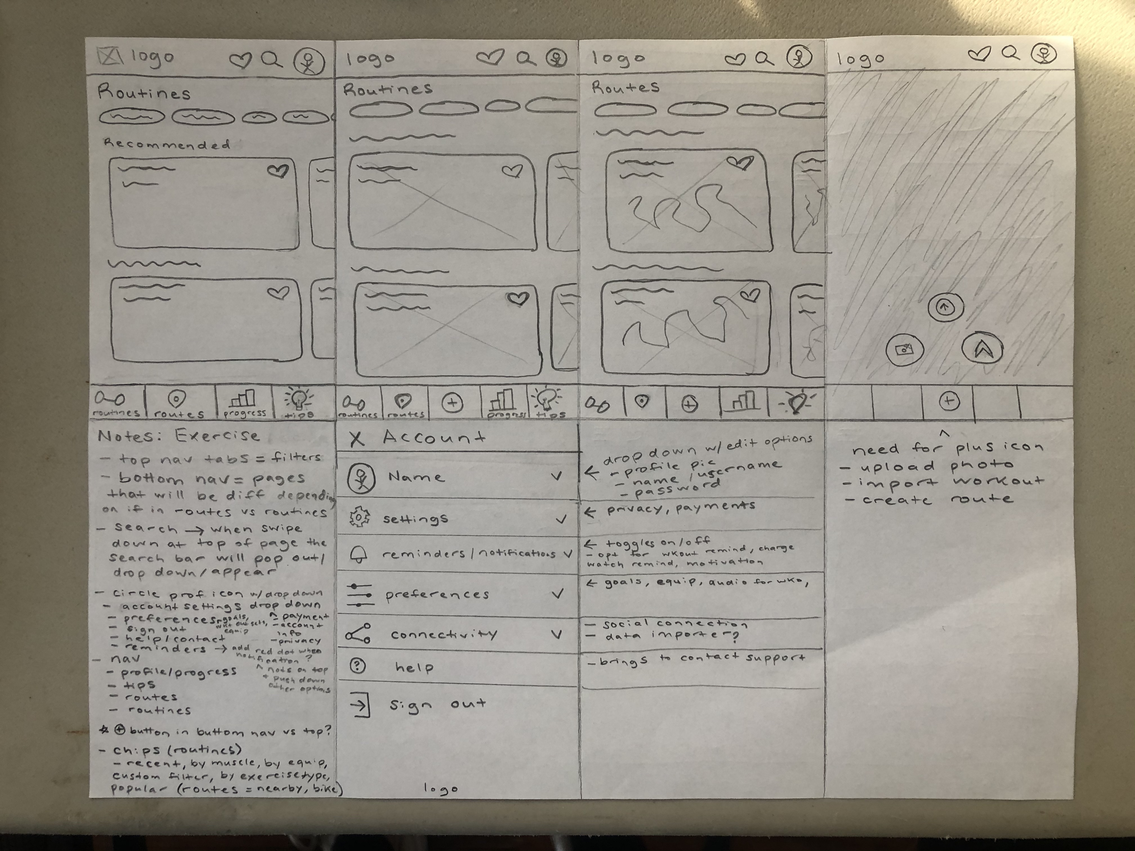
V1 - Sketch

Slide 2
V3 – Low Fidelity Prototype

Slide 3
V6 – Mid Fidelity Prototype

Slide 4
V7 – High Fidelity Prototype

Slide 5
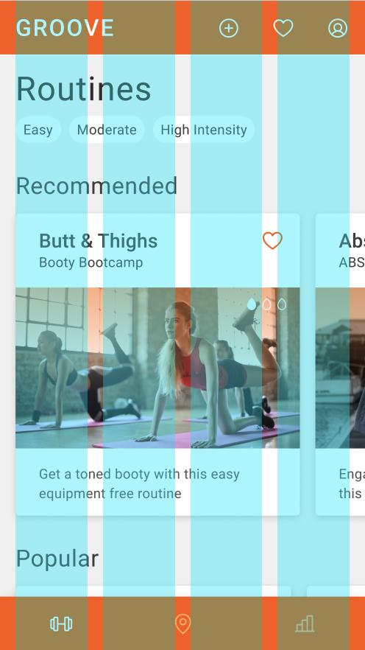
V7 – Grids

Slide 6
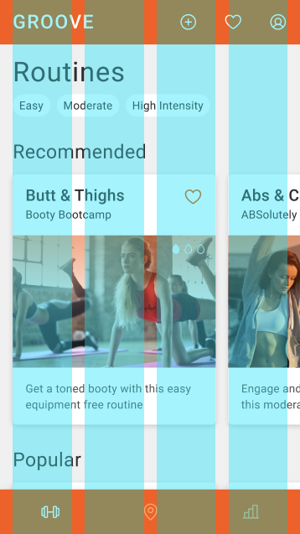
V8 – Grid Fixed

Slide 7
V8 – Grid Fixed

Slide 8
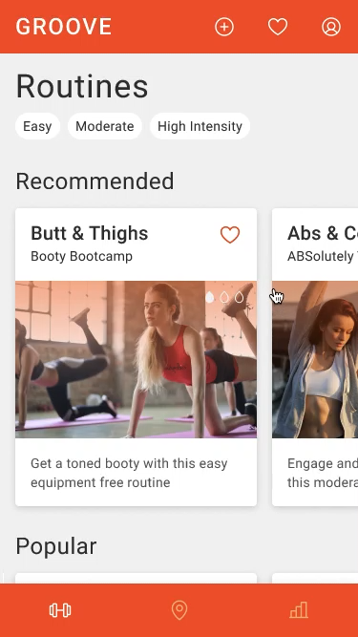
V11 – Polishing (Peer Review, Accessibility, etc.)

Slide 9
Version 1 - Sketch

Slide 10
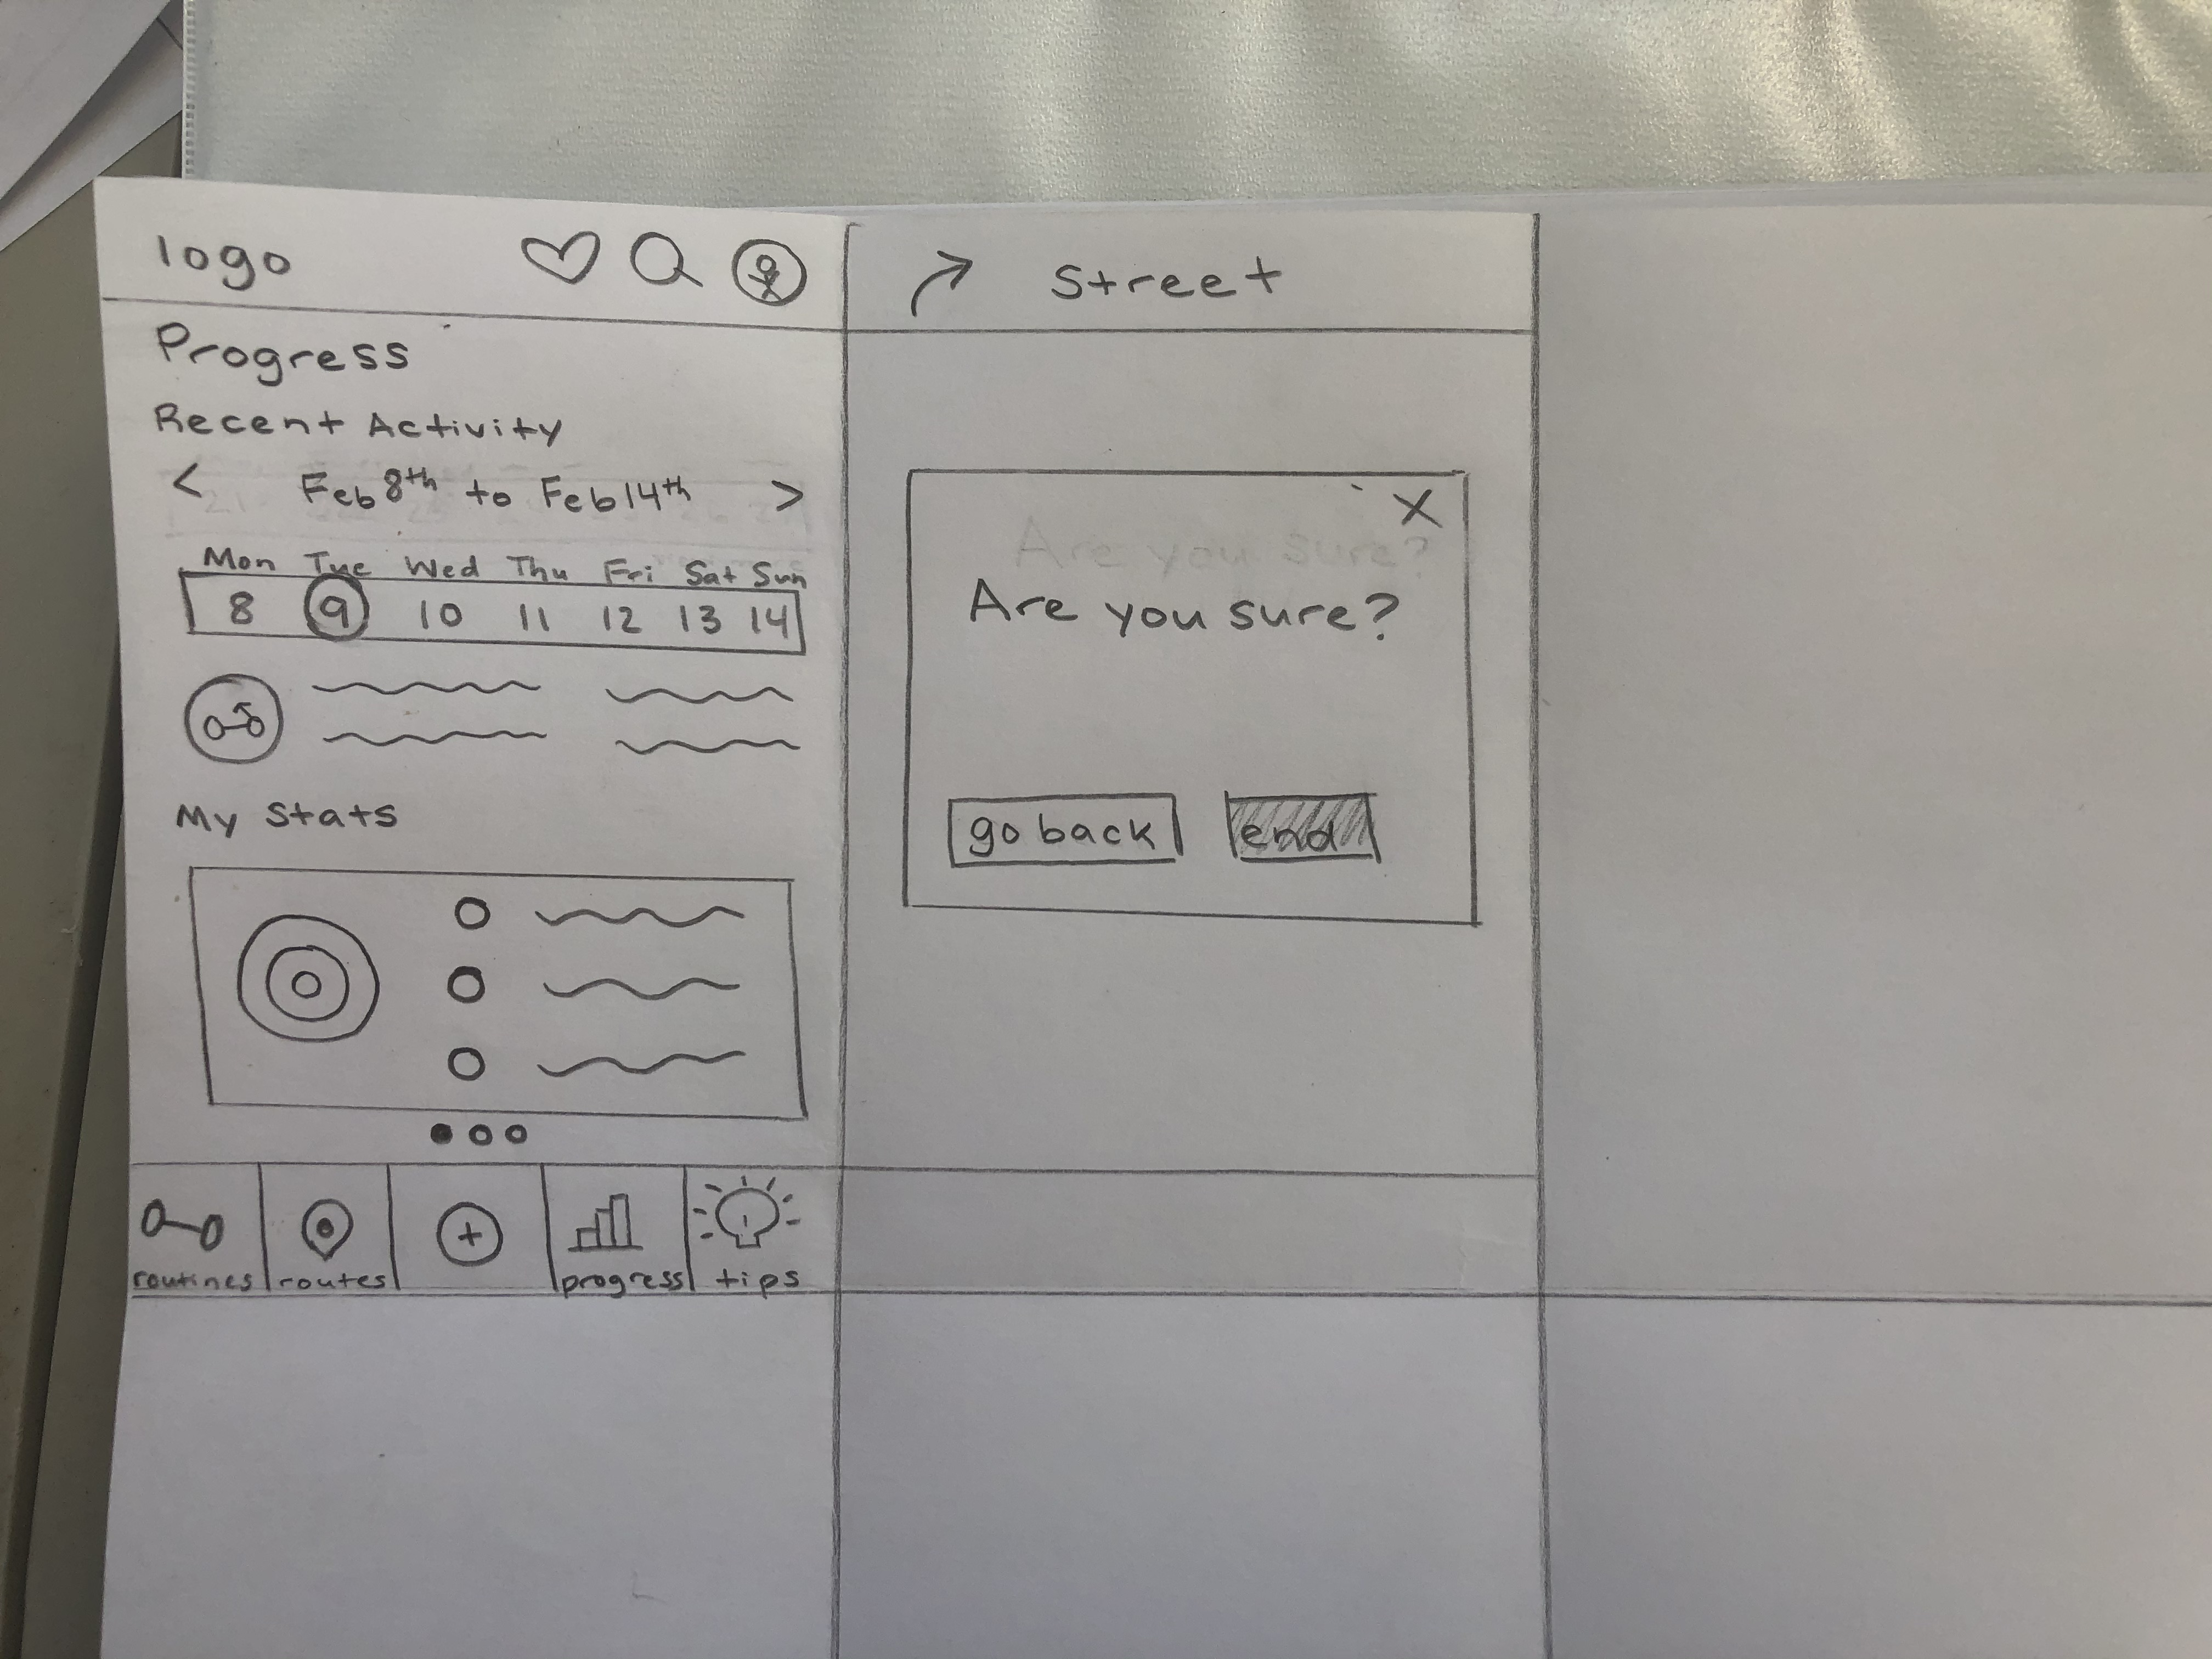

Slide 17
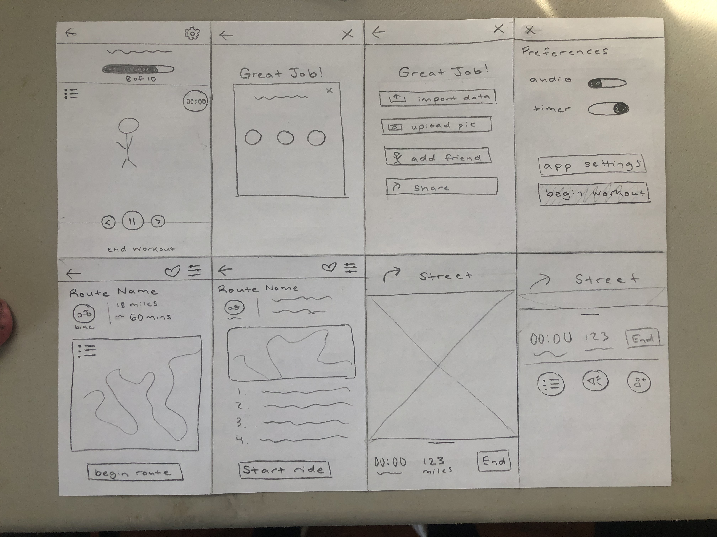

Slide 21
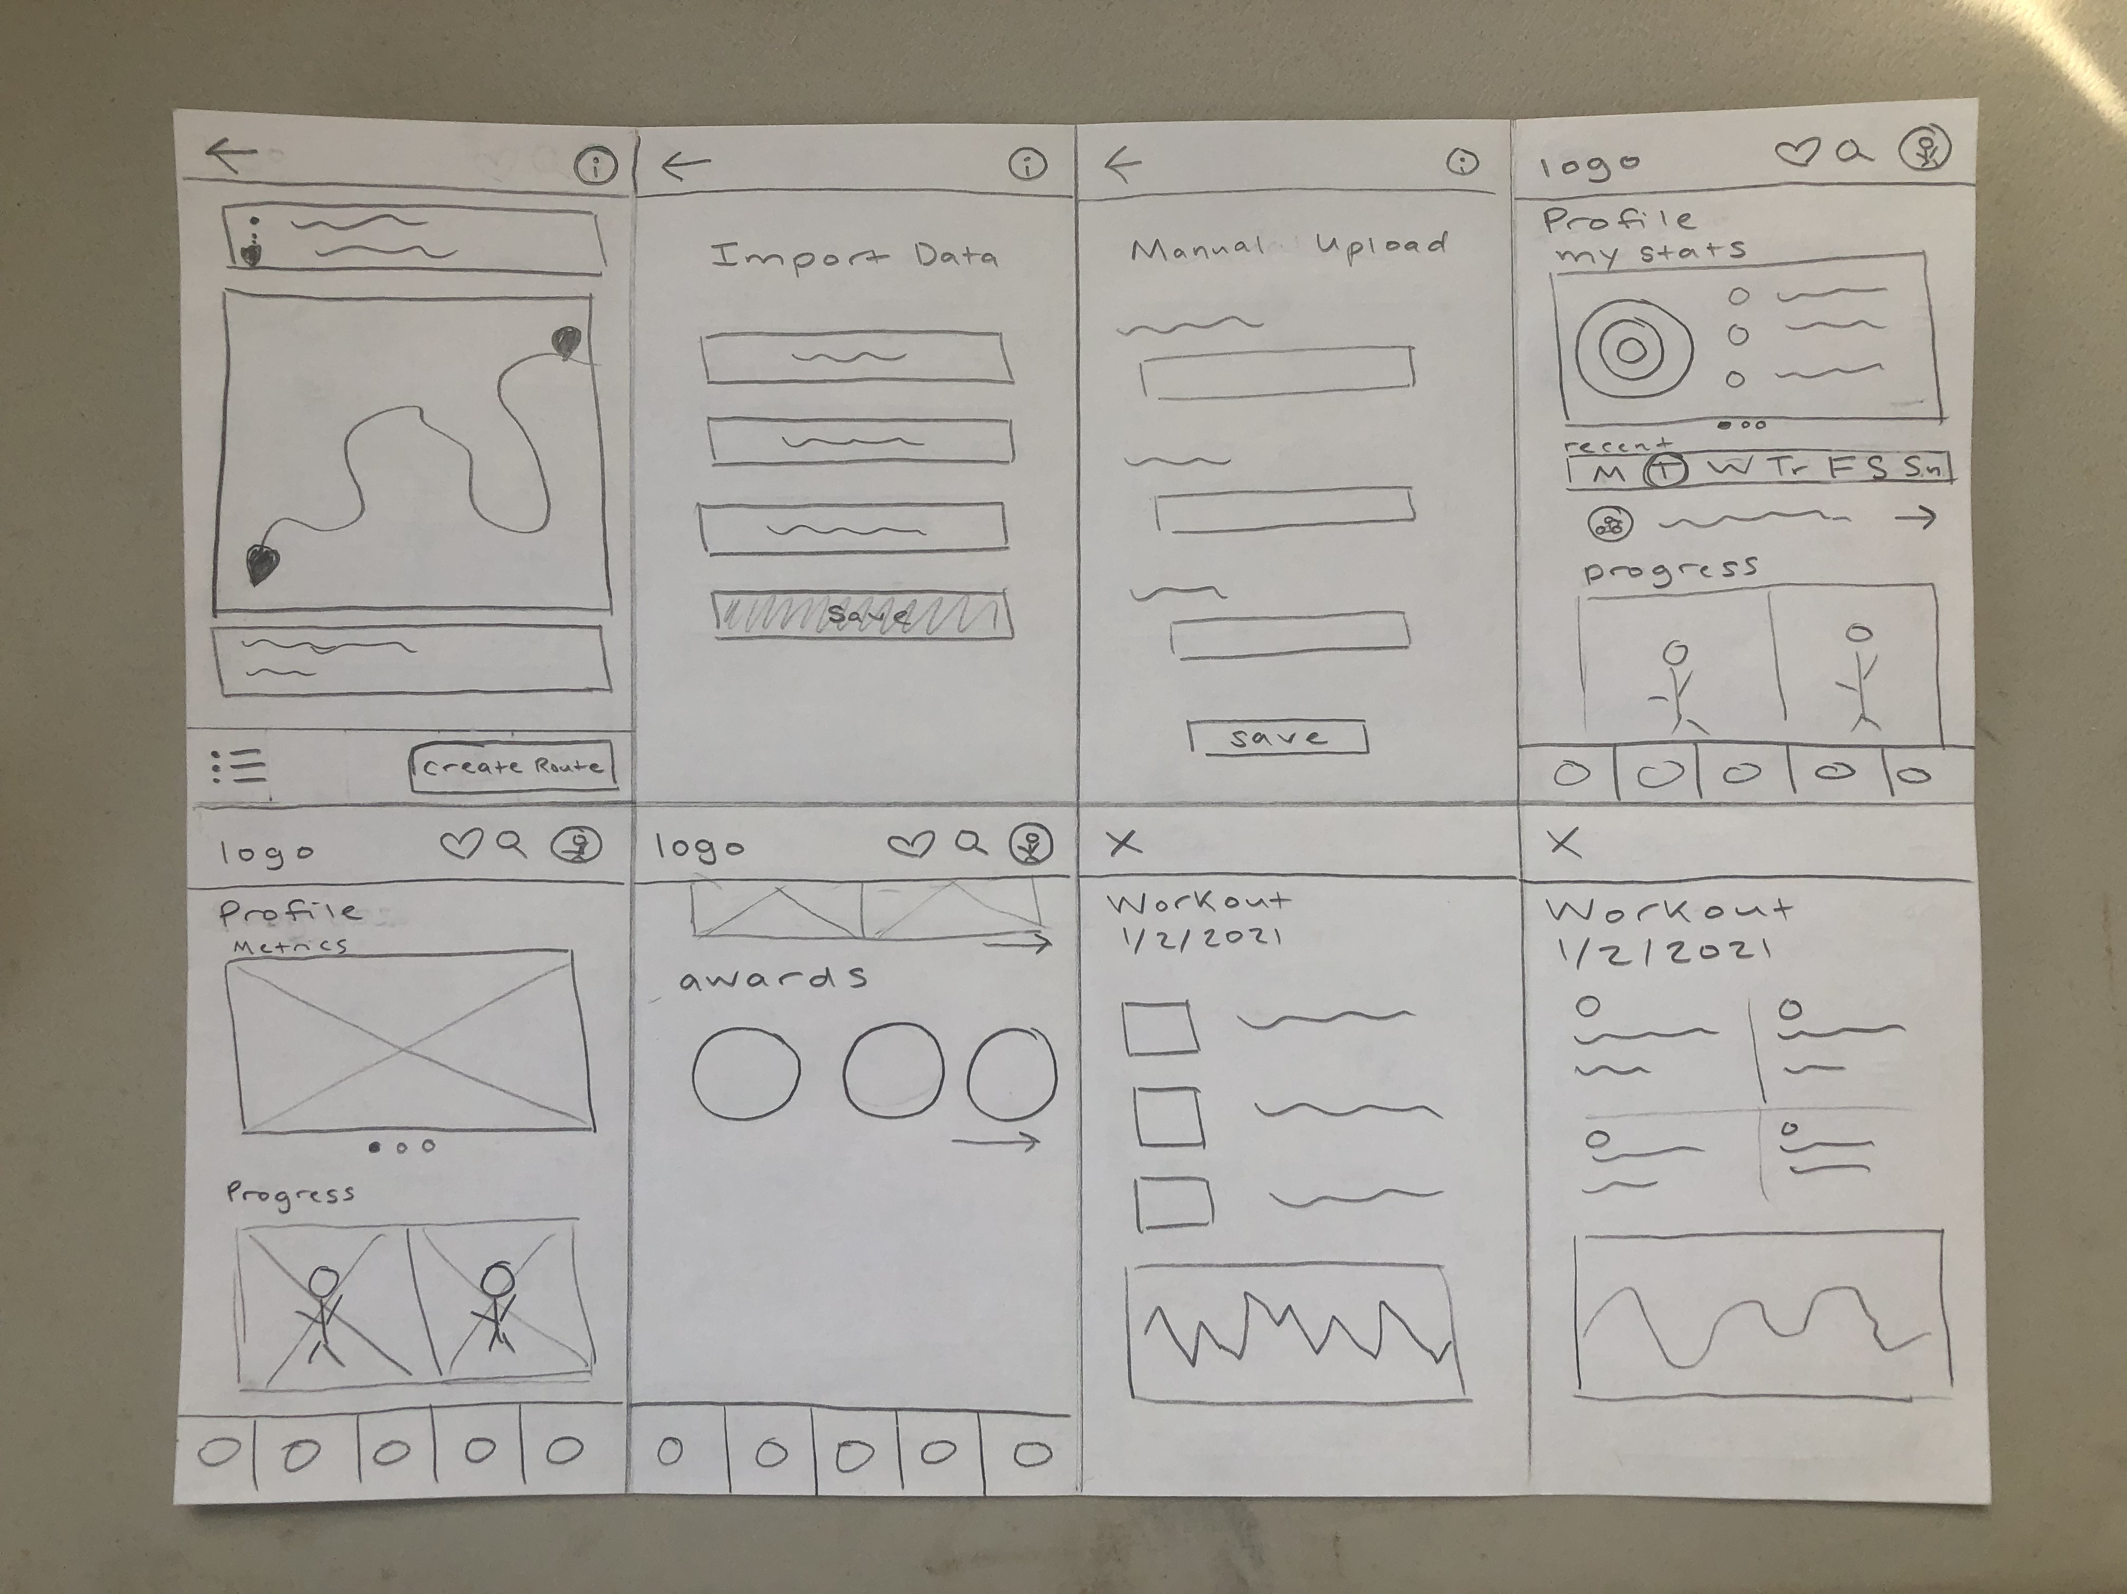

Slide 32


